Slide 1
What is pollution
Pollution Pollutants are the key elements or components of pollution which are generally waste materials of different forms. Pollution disturbs our ecosystem and the balance and the balance in the environment. With rise of population and in increase in industries the problem of pollution is becoming more serious. Nowadays the air soil and water are polluted. The water of river is no longer suitable for drinking. The air is no longer fit for breathing. Release of industrial waste mining and deforestation exploits the soil. Pollution not only affect human beings but also affects the nature plants fruits vegetables forests animals etc. It is crucial to control pollution as the nature wildlife and human life are precious gifts to the mankind. We must take steps to reduce pollution.

Slide 2
Types of pollution
Air pollution
Water pollution
Soil pollution
Thermal pollution
Radioactive pollution
Noise pollution
Light pollution

Slide 3
What is air pollution
Air pollution can be defined as an alteration of air quality that can be characterized by measurements of chemical, biological or physical pollutants in the air. Therefore, air pollution means the undesirable presence of impurities or the abnormal rise in the proportion of some constituents of the atmosphere. It can be classified in 2 sections: visible and invisible air pollution.

Slide 4
Effect of air pollution on human body
Our continual exposure to air pollutants is responsible for the deterioration of human health. Air pollution is indeed a significant risk factor for human health conditions, causing allergies, respiratory and cardiovascular diseases as well as lung damage.

Slide 5
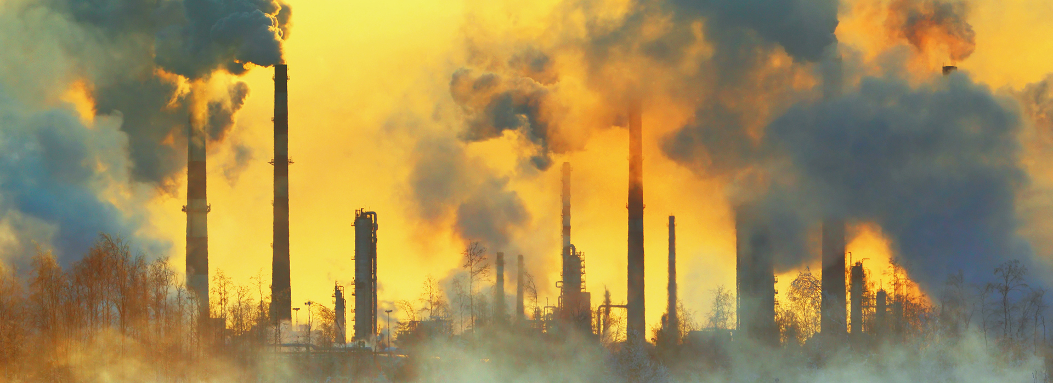
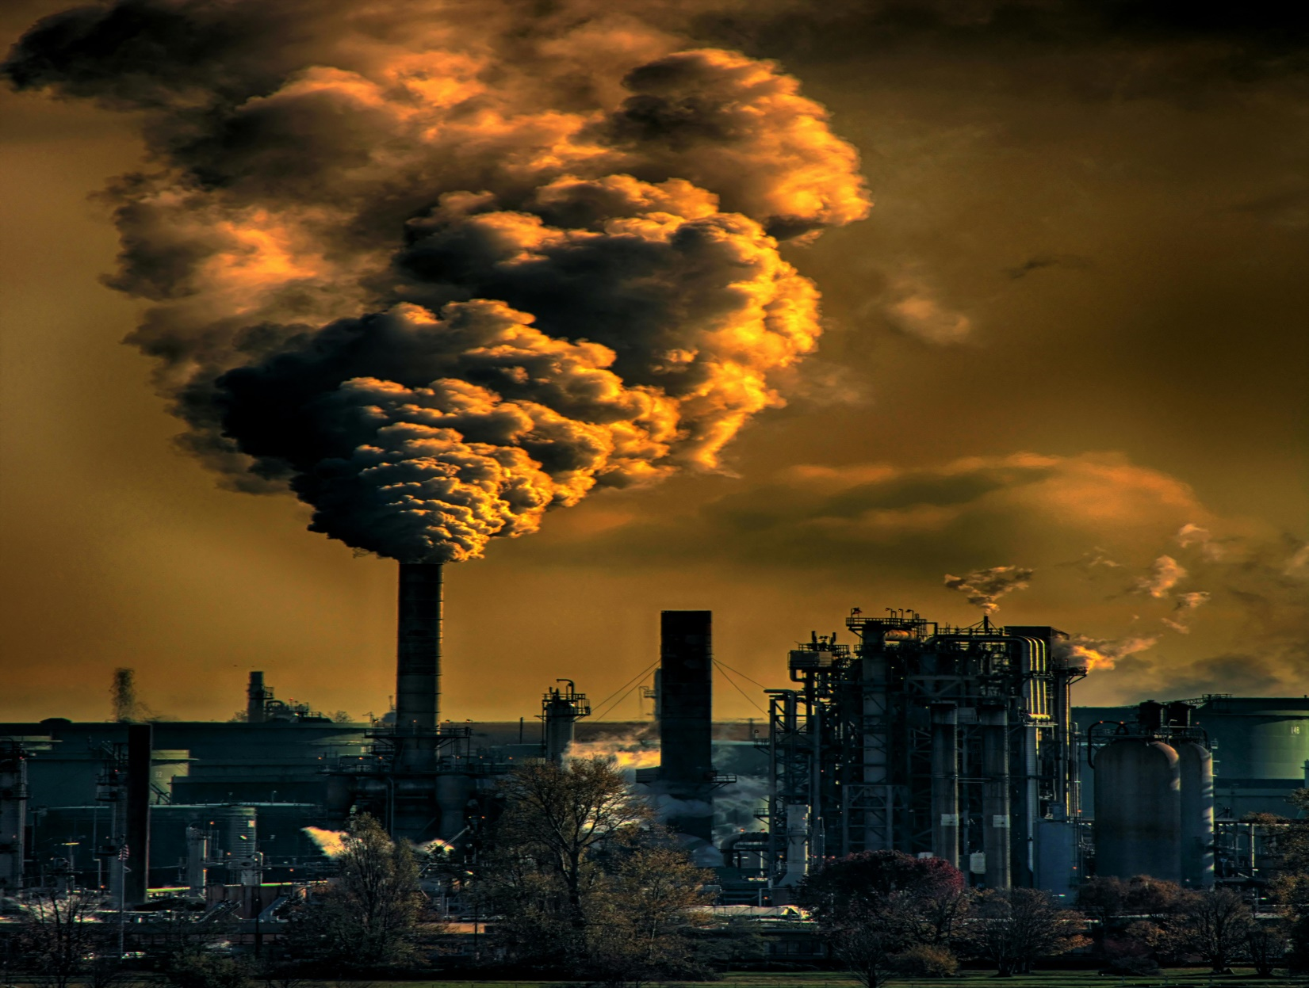
Air pollution

Slide 6
Water pollution
Water pollution occurs when harmful substances—often chemicals or microorganisms—contaminate a stream, river, lake, ocean, aquifer, or other body of water, degrading water quality and rendering it toxic to humans or the environment.
This widespread problem of water pollution is jeopardizing our health. Unsafe water kills more people each year than war and all other forms of violence combined. Meanwhile, our drinkable water sources are finite: Less than 1 percent of the earth’s freshwater is actually accessible to us. Without action, the challenges will only increase by 2050, when global demand for freshwater is expected to be one-third greater than it is now.

Slide 7
Effect of water pollution on human body
. Water pollution has very negative effects on public health. A lot of diseases result from drinking or being in contact with contaminated water, such as diarrhea, cholera, typhoid, dysentery or skin infections. In zones where there is no available drinking water, the main risk is dehydration obviously

Slide 8
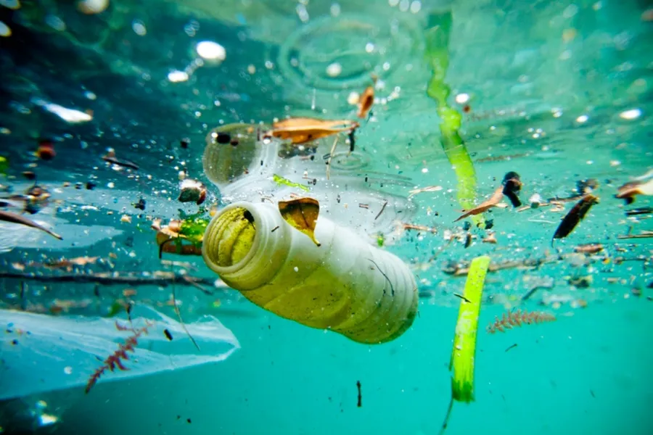
Water pollution

Slide 9
